Slide 1
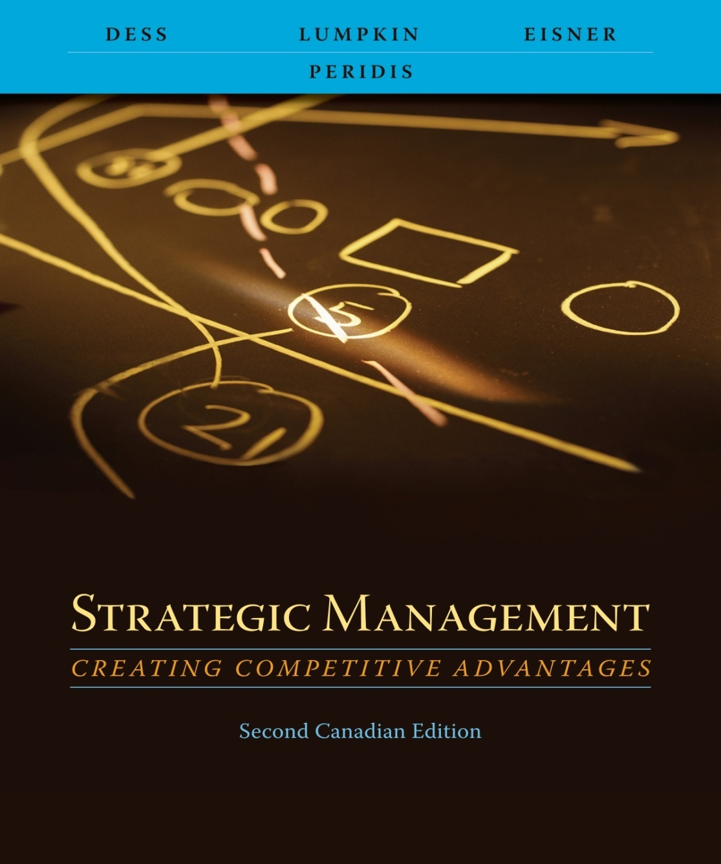
Chapter 1
Strategic Management: Creating Competitive Advantage:
An Overview

Slide 2
Learning Objectives
After reading this chapter,
you should have a good understanding of:
    The essence and definitions of strategy, strategic management, and competitive advantages.
    The four key attributes of strategic management and the three principal and interrelated activities of the strategic management process.
    The vital role of corporate governance and stakeholder management in the strategic management process and the long-term success of all organizations.
    4. The key environmental forces that create unpredictable change and call for a greater strategic management perspective throughout the organization.
    5 How an awareness of a hierarchy of strategic goals can help an organization achieve coherence in its strategic direction.

Slide 3
Strategic Management Concepts
Definition
Strategic management consists of the analysis, decisions, and actions an organization undertakes in order to create and sustain competitive advantages.
Strategic management is the study of why some firms outperform others
  How to compete in order to create competitive advantages in the marketplace
  How to create competitive advantages in the market place
    Unique and valuable
    Difficult for competitors to copy or substitute
Adapted from Exhibit 1.1 Strategic Management Concepts

Slide 4
Strategic Management Concepts
Key attributes of strategic management
  Directs the organization toward overall goals and objectives.
  Includes multiple stakeholders in decision making
  Incorporates short-term and long-term perspectives
  Recognizes trade-offs between efficiency and effectiveness

Slide 5
Strategic Management Process
Analysis
  Strategic goals (vision, mission, strategic objectives)
  Internal and external environment of the firm
Decisions
  What industries should we compete in?
  How should we compete in those industries?
Actions
  Allocate necessary resources
  Design the organization to bring intended strategies to reality

Slide 6
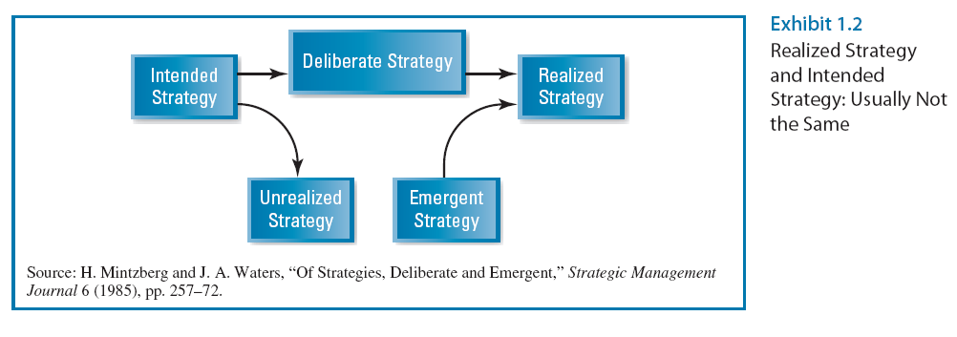
Strategic Management Process
Adapted from Exhibit 1.2 Realized Strategy and Intended Strategy: Usually Not the Same
Source: H. Mintzberg and J. A. Waters, “Of Strategies, Deliberate and Emergent,” Strategic Management Journal 6 (1985), pp. 257-72.

Slide 7
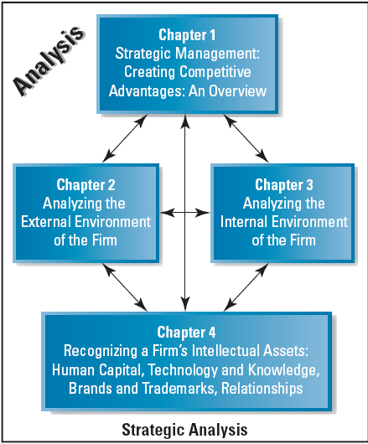
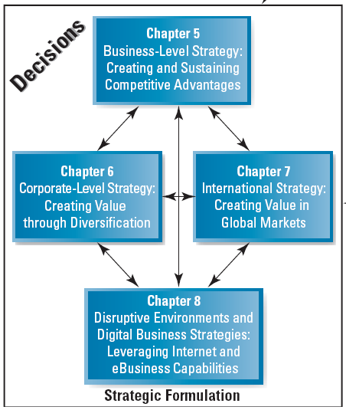
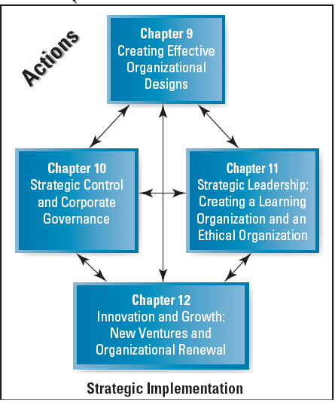
Strategic Analysis
Starting point
in the strategic
management
process
Precedes effective formulation and implementation of strategies
Exhibit 1.3 The Strategic Management Process

Slide 8
Strategic Analysis (cont.)
Clear goals and objectives permit effective allocation of resources
Hierarchy of goals
  Vision
  Mission
  Strategic objectives
Adapted from Exhibit 1.3 The Strategic Management Process

Slide 9
Strategic Analysis (cont.)
Managers
  Scan the environment
  Analyze competitors
General environment
Industry environment
Adapted from Exhibit 1.3 The Strategic Management Process

Slide 10
Strategic Analysis (cont.)
Frameworks for analyzing a firm’s internal environment
  Strengths
  Weaknesses
Analyzing strengths can uncover potential sources of competitive advantage
Adapted from Exhibit 1.3 The Strategic Management Process

Slide 11
Strategic Analysis (cont.)
Intellectual assets are drivers of
  Competitive advantages
  Wealth creation
Networks and relationships among
  Employees
  Customers
  Suppliers
  Alliance partners
Adapted from Exhibit 1.3 The Strategic Management Process

Slide 12
Strategic Formulation
Successful firms develop bases for competitive advantage
  Cost leadership
  Differentiation
  Focusing on narrow or industry-wide market segments
Sustainability
Industry life cycle
Adapted from Exhibit 1.3 The Strategic Management Process

Slide 13
Strategic Formulation (cont.)
Firm’s portfolio or group of businesses
  What business(es) should we be in?
  How can we create synergies among the businesses?
Diversification
  Related
  Unrelated
Adapted from Exhibit 1.3 The Strategic Management Process

Slide 14
Strategic Formulation (cont.)
Appropriate entry strategies
Sustain competitive advantage in global markets
Adapted from Exhibit 1.3 The Strategic Management Process

Slide 15
Strategic Formulation (cont.)
Digital technologies change the way business is conducted
  Added value
  Impact on performance
Digital technologies can enhance
  Cost leadership
  Differentiation
Adapted from Exhibit 1.3 The Strategic Management Process

Slide 16
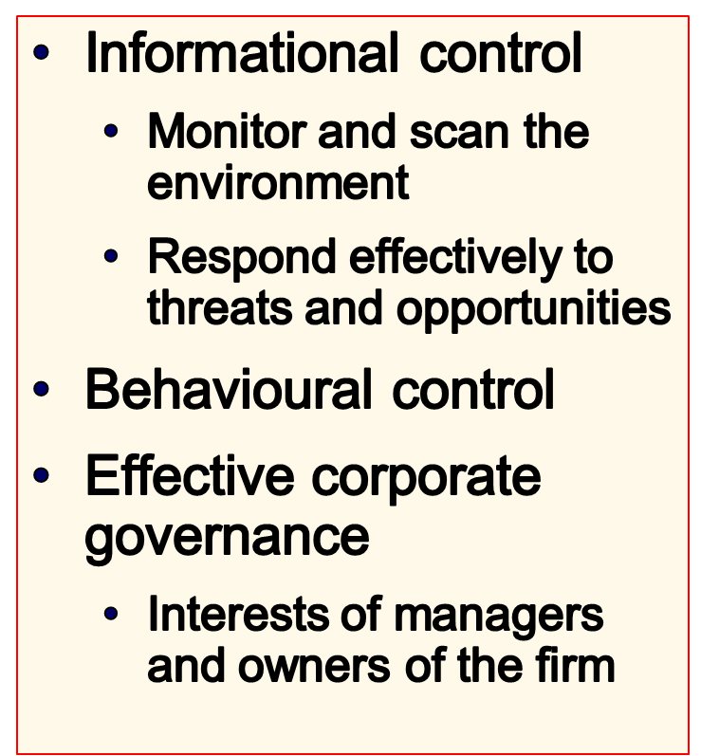
Strategic Implementation
Adapted from Exhibit 1.3 The Strategic Management Process

Slide 17
Strategic Implementation (cont.)
Organizational structure and design
Organizational boundaries
  Flexible
  Permeable
Strategic Alliances
Adapted from Exhibit 1.3 The Strategic Management Process

Slide 18
Strategic Implementation (cont.)
Develop organization that is committed to
  Excellence
  Ethical behaviour
Learning organization responsive to
  Rapid and unpredictable change in today’s competitive environments
Adapted from Exhibit 1.3 The Strategic Management Process

Slide 19
Strategic Implementation (cont.)
Corporate entrepreneurship and innovation
  New opportunities
  Enhance innovative capacity
  Autonomous entrepreneurial behaviour
  Product champions
Adapted from Exhibit 1.3 The Strategic Management Process

Slide 20
Strategic Implementation (cont.)
New ventures and small businesses
  Major engine of economic growth
  Recognize viable opportunities
  Entrepreneurial leadership skills
Adapted from Exhibit 1.3 The Strategic Management Process

Slide 21
Corporate Governance and
Stakeholder Management
Corporate Governance
Definition
the relationship among various participants in
determining the direction and performance of corporations:
  Shareholders
  Management
  Board of directors
    Elected representatives of the owners
    Ensure interests and motives of management are aligned with those of the owners
    Effective and engaged board of directors
    Shareholder activism
    Proper managerial rewards and incentives

Slide 22
Social Responsibility
Definition
the expectation that businesses or individuals will strive to improve the overall welfare of society
Requires
  Managers must take active steps to make society better
  Socially responsible behaviour changes over time
  Triple Bottom Line

Slide 23

Four Additional Types of Capital
In addition to financial capital
Type of Capital
Description
Ecological
Renewable resources generated by living systems, such as wood or animal by-products
Material
Nonrenewable or geological resources such as mineral ores and fossil fuels
Human
People’s knowledge, skills, health, nutrition, safety, security, and motivation
Social
Assets of civil society, such as social cohesion, trust, reciprocity, equity, and other values that provide mutual benefit

Slide 24
Strategic Management Perspective
Integrative view of the organization
Assess how functional areas and activities “fit together” to achieve goals and objectives
All managers and employees must take and integrative, strategic perspective of issues facing the organization

Slide 25
Strategic Management Perspective
Key driving forces increasing the need for strategic perspective and involvement
  Globalization
  Technology
  Intellectual capital
These forces are
  Interrelated
  Accelerating the rate of change and uncertainty

Slide 26



Enhancing Employee Involvement
Local Line Leaders
Have significant profit and loss responsibility
Executive Leaders
Champion and guide ideas
Create a learning infrastructure
Establish a domain for taking action
Internal Networkers
Have little positional power and formal authority
Generate their power through the conviction and clarity of their ideas

Slide 27
Coherence in Strategic Direction
Company Vision
Inspiring
Overarching
Long-term
Driven by and evokes passion
Fundamental statement of the organization’s
  Values
  Aspiration
  Goals
Company vision
Mission statements
Strategic objectives
Mission statements
Purpose of the company.
Basis of competition and competitive advantages.
More specific than vision.
Focused on the means by which the firm will compete
Strategic Objectives
Operationalize the mission statement
Provide guidance on how the organization can fulfill or move toward the “higher goals”
Measurable; Specific; Appropriate; Realistic;Timely
Yardstick for rewards and incentives

